Slide 1
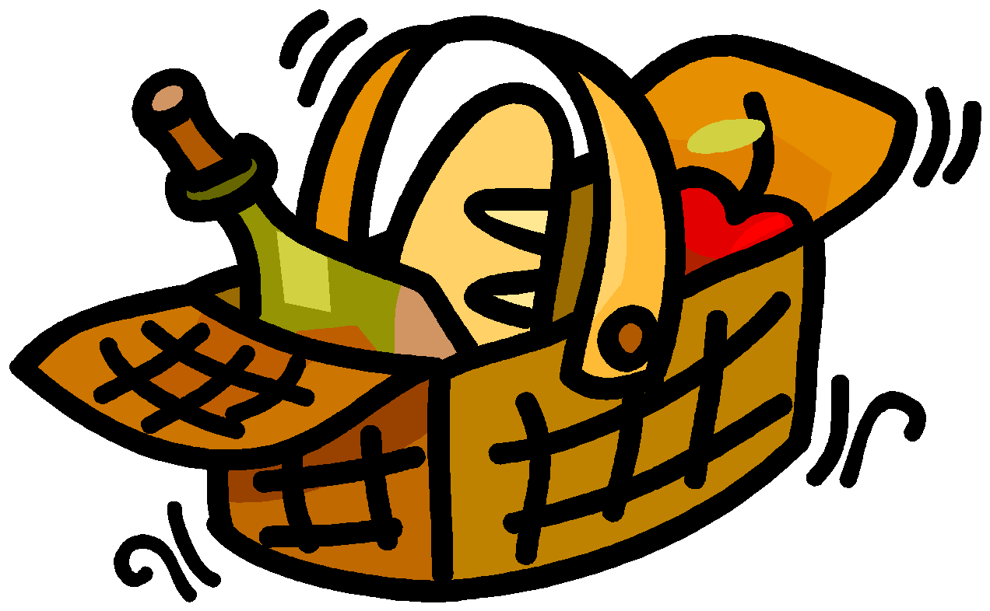

If Music Be The Food Of Love

Slide 2
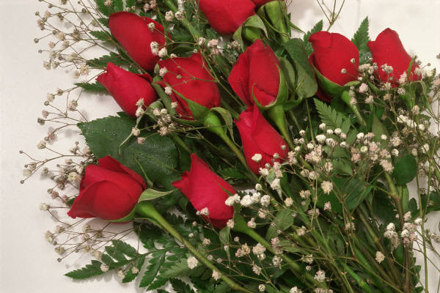
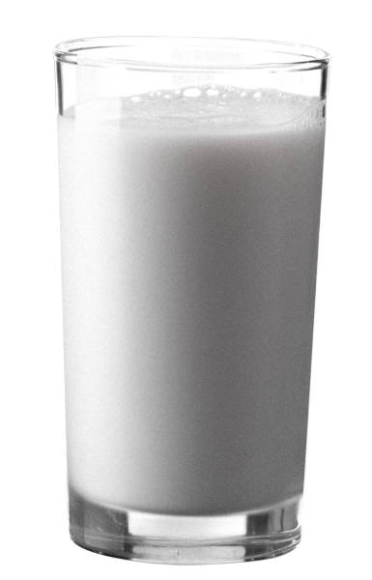
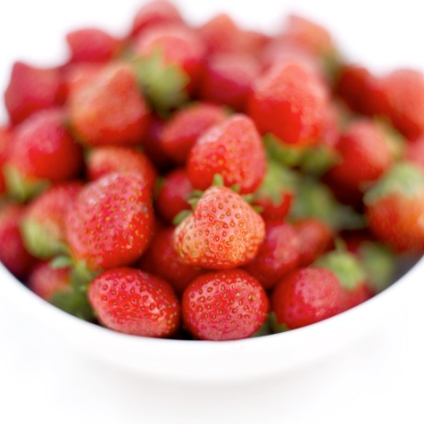
3)Who will buy my sweet red roses, two blooms for a penny,
3)Who will buy my sweet red roses, two blooms for a penny,
1)Any milk today mistress? Any milk today mistress?
3)Who will buy my sweet red roses,
1)Any milk today mistress?
3)Two blooms for a penny,
2)Ripe strawberries ripe! Ripe strawberries ripe!
1)Any milk today mistress?
2)Ripe strawberries ripe!
3)Who will buy my sweet red roses,
2)Ripe strawberries ripe!
All)Who will buy?

Slide 3

Peanuts! Peanuts!
In Cuba each merry maid wakes up to this serenade,
Peanuts! Peanuts!
If you haven’t got bananas don’t be blue,
Peanuts in a little bag are calling you,
Don’t waste them no tummy ache,
You’ll taste them when you awake,
For at the very break of day the peanut vendor’s on his way,

Slide 4
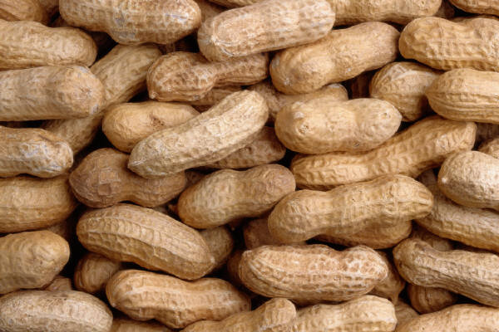
A)
Peanuts!
Peanuts!
Peanuts!
Peanuts!
If you’re looking for an
early morning treat,
Get some double jointed
peanuts good to eat!
B)
Come get them they’re nice and hot,
They’re roasted, he sells a lot,
We hear him cry,
They all reply.
If you’re looking for an
early morning treat,
Get some double jointed
peanuts good to eat!

Slide 5
A)
For breakfast,
Or dinner time,
Or supper,
Most anytime,
If you’re looking for a
moral to this song,
Fifty million little monkeys
can’t be wrong.
Peanuts! Peanuts!
Peanuts!
B)
Peanuts!
Peanuts!
If you’re looking for a
moral to this song,
Fifty million little monkeys
can’t be wrong.
Peanuts! Peanuts!
Peanuts!

Slide 6
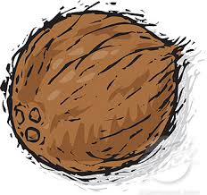
I’ve got loverly bunch of coconuts,
Here they are a standing in a row,
Big ones, small ones, some as big as your ‘ead,
You give ‘em a twist, a flick of yer wrist,
That’s what the showman said,
Oh I’ve got a loverly bunch of coconuts,
Every ball you throw will make me rich.

Slide 7
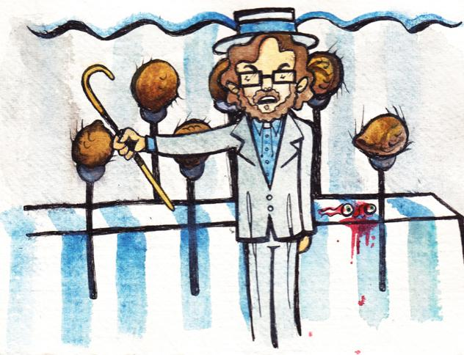
There stands me wife, the idol of me life,
Singing roller bowler ball a penny a pitch
Singing roller bowler ball a penny a pitch.
Roller bowler ball a penny a pitch
Roller bowler ball, roller bowler ball
Singing roller bowler ball a penny a pitch.

Slide 8
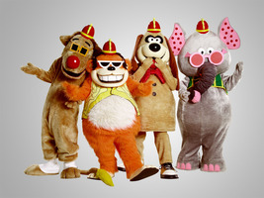
One banana, two banana, three banana four,
Four bananas make a bunch and so do many more.
Over hill and highway the banana buggies go
Come along to bring you the banana splits show.
Making up a mess of fun.
Making up a mess of fun.
Making up a mess of fun.
Tralala, lala la la, Tralala, lala la la.
Tralala, lala la la, Tralala, lala la la.

Slide 9
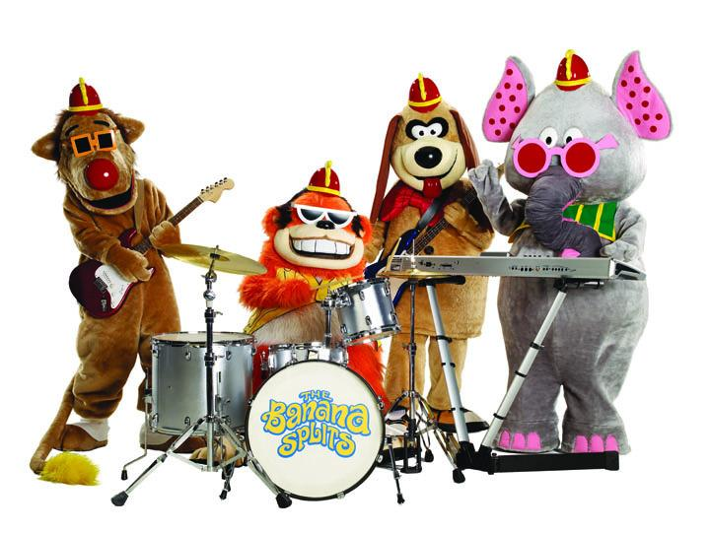
Four banana three banana two banana one,
Four bananas playing in the bright warm sun,
Come on everybody won’t you come along a see,
How much like banana splits everyone can be.
Making up a mess of fun
Making up a mess of fun
Making up a mess of fun
Tralala, lala la la, Tralala, lala la la.
Tralala, lala la la, Tralala, lala la la.

Slide 10

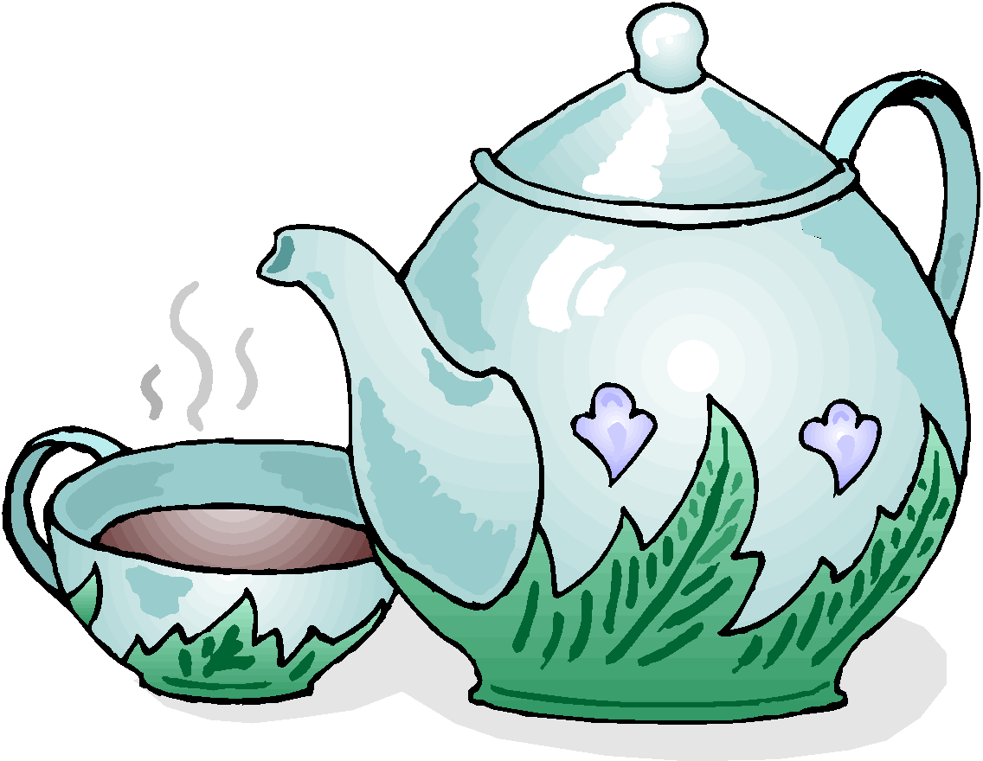
I love coffee, I love tea,
I love the java jive and it loves me,
Coffee and tea and the java and me,
A cup, a cup, a cup, a cup, a cup, (sip) aah!
I love java, sweet and hot,
Whoops, Mister Moto I’m a coffee pot,
Shoot me the pot, and I’ll pour me a shot,
A cup, a cup, a cup, a cup, a cup.

Slide 11


Slip me a slug from the wonderful mug,
And I’ll cut a rug til I’m snug in a jug,
A slice of onion and a raw one,
Draw one, waiter waiter perculator,
I love coffee, I love tea,
I love the java jive and it loves me,
Coffee and tea and the java jive and me,
A cup, a cup, a cup, a cup, a cup. (sip, aahh)

Slide 12
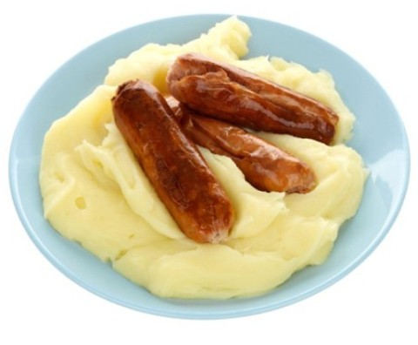
I met her down in Napoli and didn’t she look great.
And so I brought her back to blighty
Just to show me mates,
And now we’re married happily I’ll tell you furthermore
I haven’t had a decent meal since nineteen forty four!
Girls: “Eat your Minestone Joe”
Boys: “is all you ever say”
Girls: “Eat your Macaroni Joe”
Boys: “Every blooming day!”
Girls: No wonder you’re so boney Joe and skinny as a rake,
Boys: Well then give us a bash at the bangers and mash
me mother used to make.

Slide 13
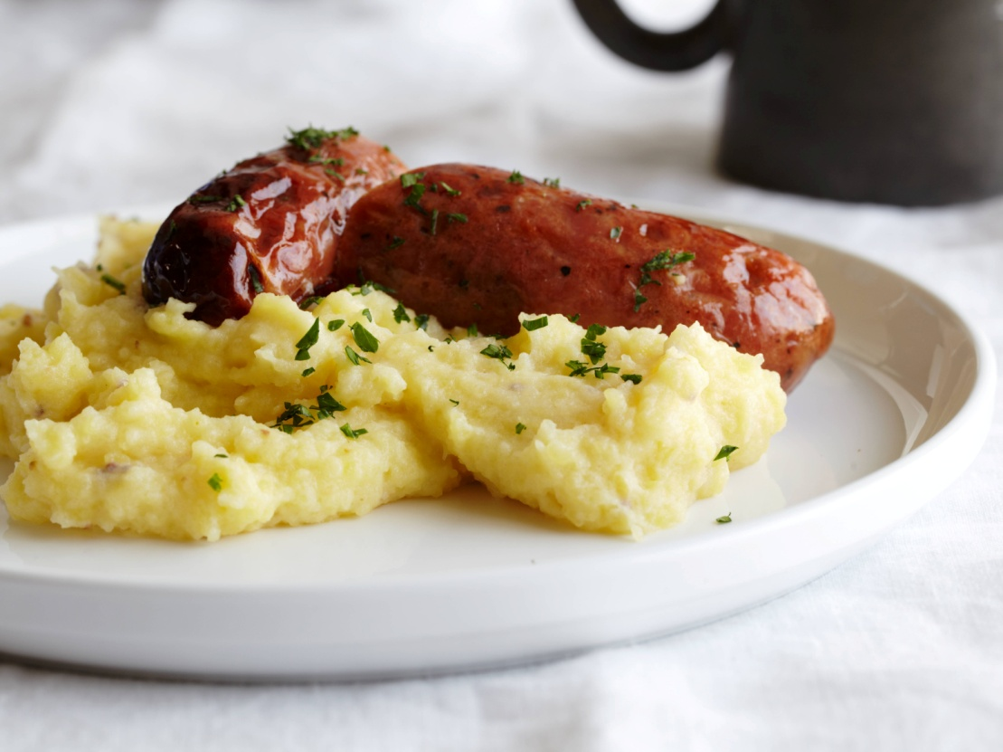
Boys: Bangers and mash,
Girls: Minestrone,
Boys: Bangers and mash,
Girls: Macaroni,
Boys: Give us a bash at the bangers and mash
me mother used to make.

Slide 14
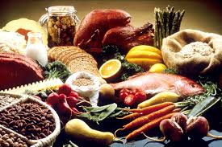
Food, glorious food, hot sausage and mustard.
While we’re in the mood, cold jelly and custard,
Pease pudding and saveloy, what next is the question?
Rich gentlemen have it boys, In-di-gestion!
Food, glorious food, we’re anxious to try it,
Three banquets a day, our favourite diet,
Just picture a great big steak,
Fried, roasted or stewed,
Oh food, marvellous food,
Wonderful food, Glorious food!

