Slide 1

Weather Medley

Slide 2
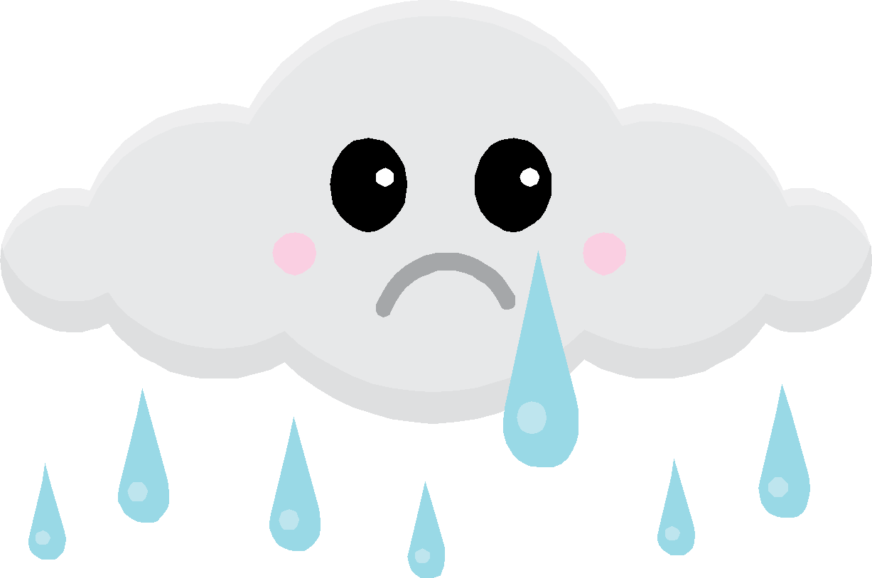
Raindrops KeepFalling On My Head
Raindrops keep falling on my head,
And just like the guy whose feet are too big for his bed,
nothing seems to fit,
those raindrops are falling on my head they keep falling,
So I just did me some talking to the sun,
And I said I didn’t like the way he got things done,
sleeping on the job,
Those raindrops are falling on my head they keep falling,
But there’s one thing I know,
the blues they send to meet me won’t defeat me
It won’t be long till happiness steps up to greet me

Slide 3

Bring Me Sunshine
Bring me sunshine in your smile
Bring me laughter all the while,
In this world where we live
there should be more happiness,
So much joy you can give
to each brand new bright tomorrow,
Make me happy through the years
Never bring me any tears
Let your arms be as warm as the sun from up above
bring me fun bring me sunshine, bring me love.

Slide 4

Jeepers Creepers
I don’t care what the weatherman says
when the weatherman says it’s raining,
You’ll never hear me complaining
I’m certain the sun will shine.
I don’t care where the weathervane points
When the weathervane points to gloomy
It’s gotta be sunny to me when your eyes look into mine,
Jeepers creepers, Where d’ya get those peepers?
Jeepers creepers, where d’ya get those eyes?
Gosh Oh git up, How’d they get so lit up?
Gosh Oh git up, How they hypnotise!

Slide 5

The Rhythm Of The Rain
Listen to the rhythm of the falling rain
Telling me just what a fool I’ve been.
I wish that it would go and let me cry in pain,
And let me be alone again.
The only girl I care about has gone away.
looking for a brand new start
But little does she know that when she left that day
Along with her she took my heart.
Rain please tell me now does that seem fair,
For her to steal my heart away when she don’t care
I can’t love another when my heart’s so far far away.

Slide 6

Here Comes The Sun
Here comes the sun do d’n do do
Here comes the sun and I say, “It’s alright”
Little darling, It’s been a long cold lonely winter,
Little darling, It feels like years since it’s been here,
Here comes the sun do d’n do do
Here comes the sun and I say, “It’s alright”
Sun, sun, sun here it comes
Sun, sun, sun here it comes
Sun, sun, sun here it comes

Slide 7

Have You Ever Seen The Rain?
Someone told me long ago,
There’s a calm before the storm, I know,
It’s been coming for some time
When it’s over so they say, It’ll rain a sunny day, I know,
Shining down like water,
I wanna know, Have you ever seen the rain?
I wanna know, Have you ever seen the rain,
Comin’ down on a sunny day?

Slide 8

Walking On Sunshine
I used to think maybe you loved me Now baby I’m sure,
And I just can’t wait till the day when you knock on my door,
Now everytime I go for the mailbox gotta hold myself down
‘Cos I just can’t wait till you write me you’re coming around
I’m walking on sunshine, woah
I’m walking on sunshine, woah!
I’m walking on sunshine, woah!
And don’t it feel good! Hey!
And don’t it feel good! Hey! Alright now,
and don’t it feel good! I’ll singit I’ll sing it I’ll sing it again now,
And don’t it feel good! Aright now, and don’t it feel good!

